Slide 1
The Machine Learning & Deep Learning Show
Lecture 03
18th June 2020

Slide 2
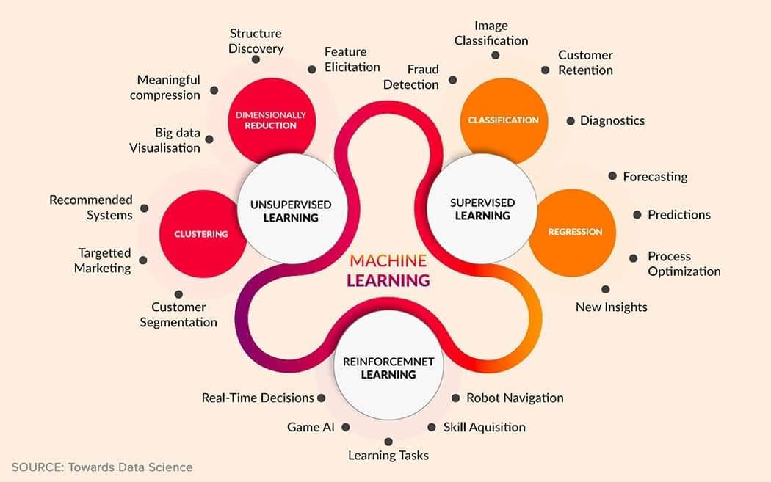
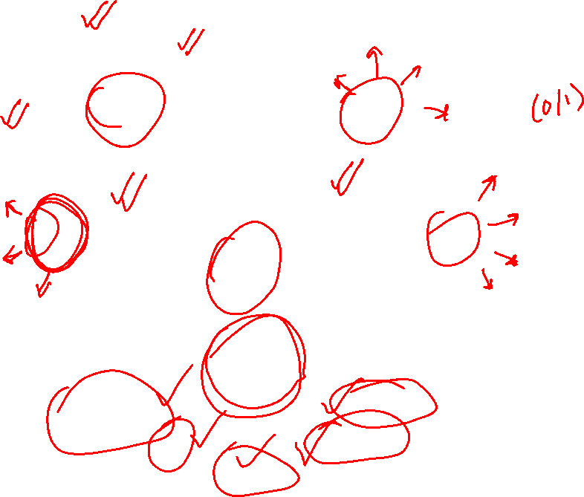

Slide 3
Artificial Neural Networks (Deep Learning)

Slide 4
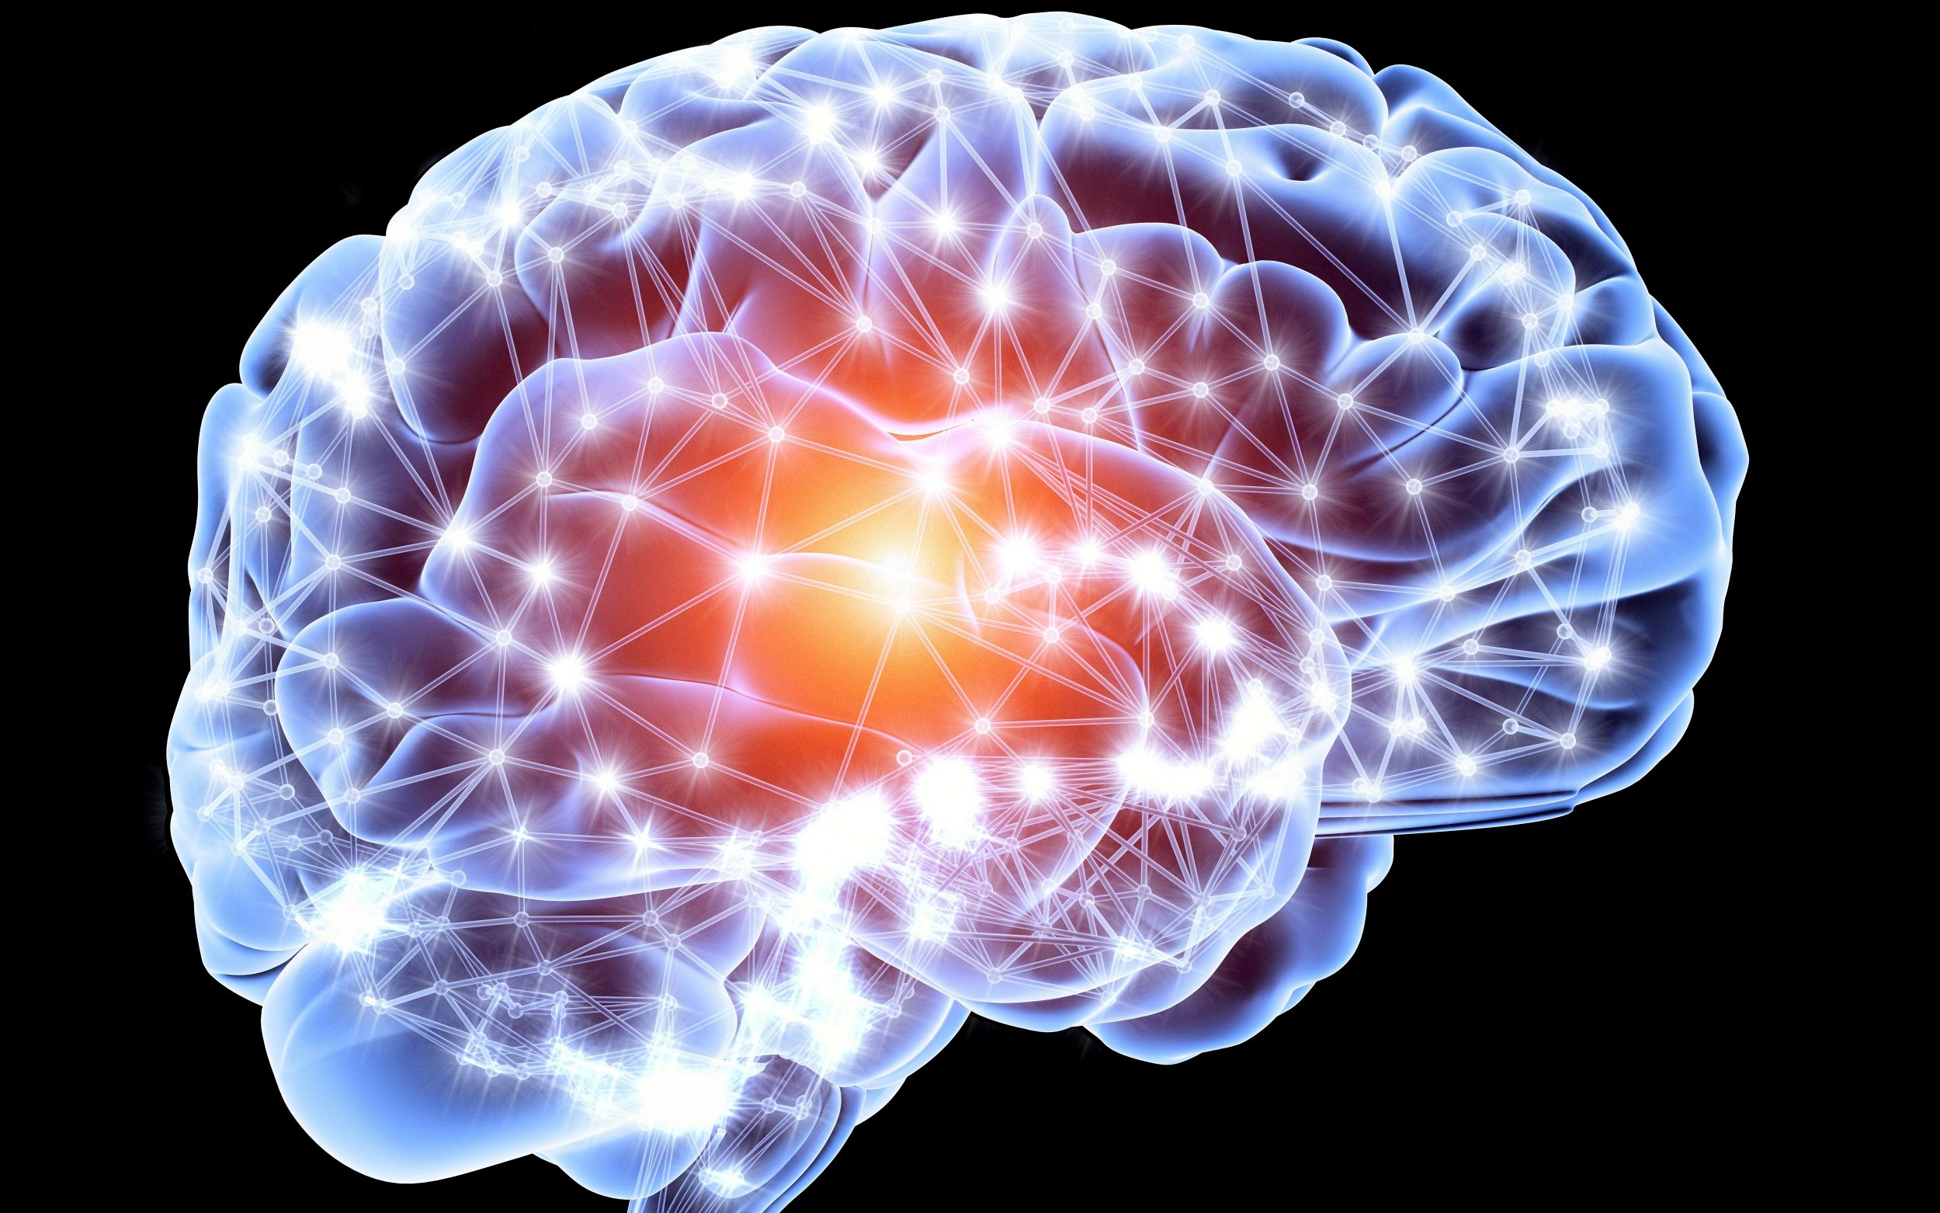
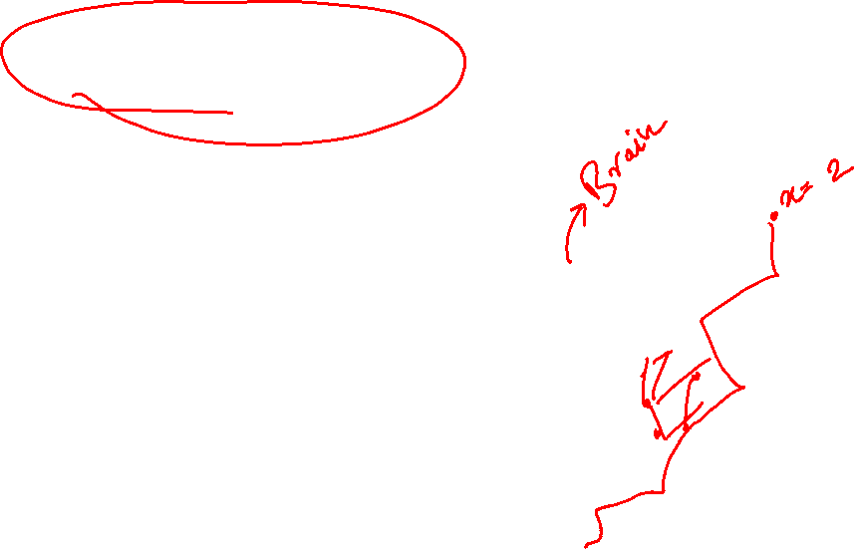
What are Neural Networks?
An artificial neural network is an interconnected group of nodes, inspired by a simplification of neurons in a brain.

Slide 5
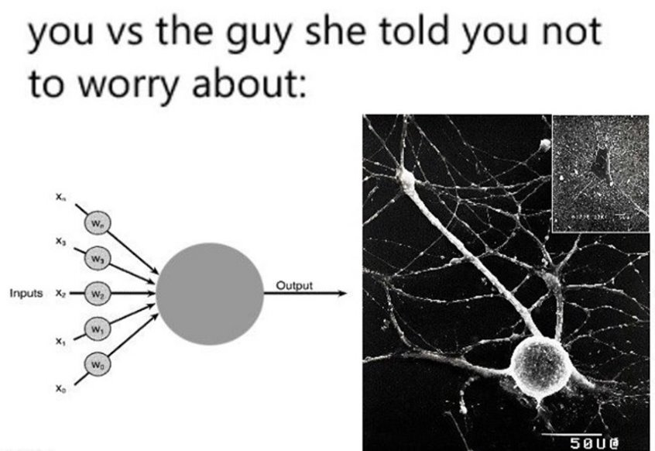
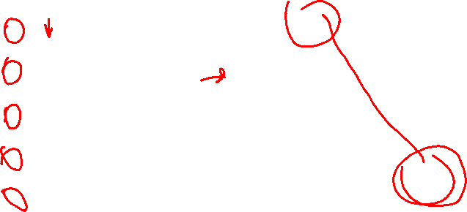
What are Neural Networks?

Slide 6
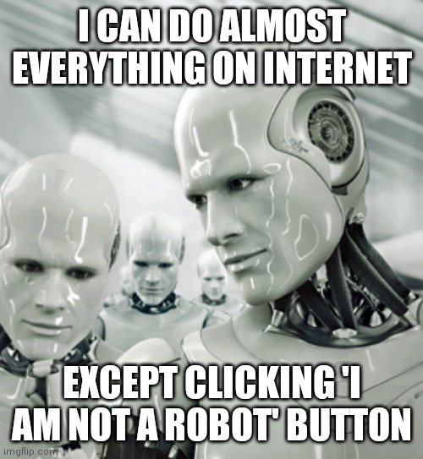
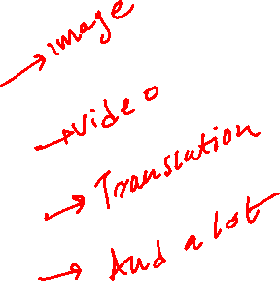
Applications of Neural Networks:
Understanding ML through Memes

Slide 7
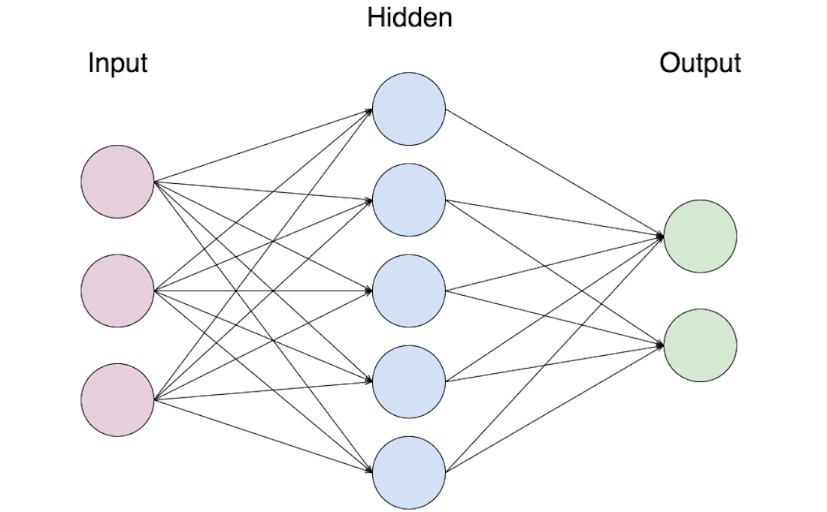
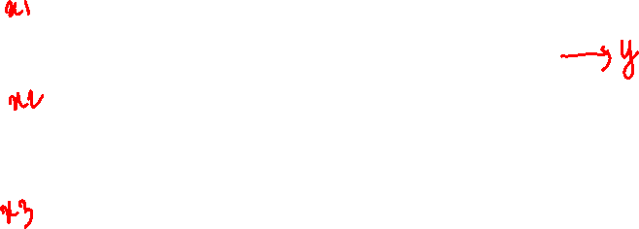
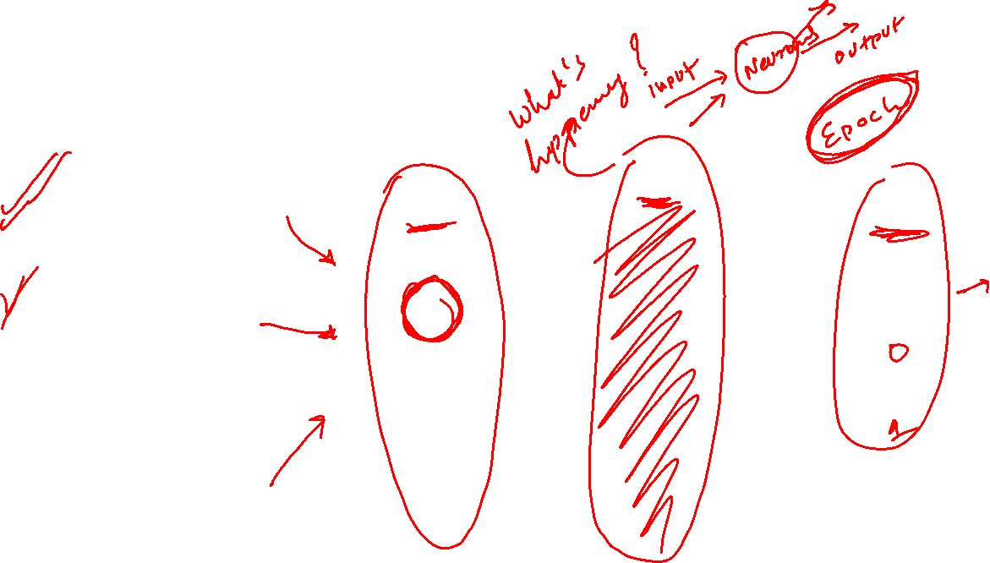
Terminologies in Architecture
Neurons
Layers
Input Output Hidden

Slide 8
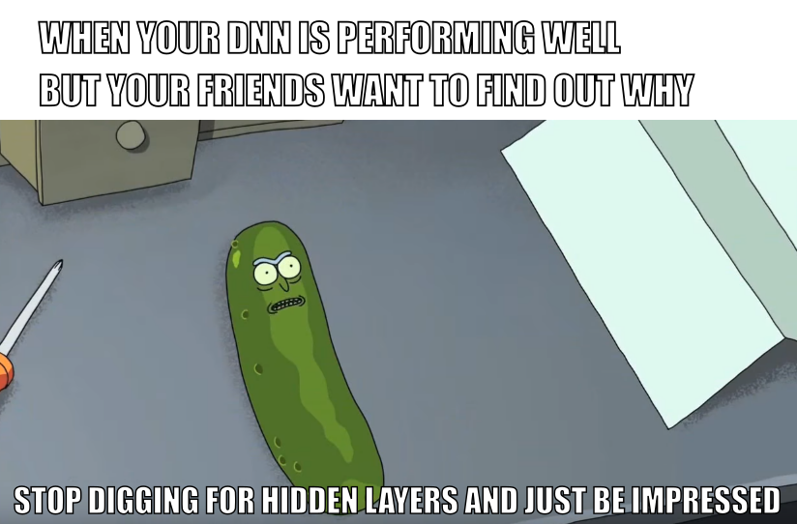
Terminologies in Architecture

Slide 9
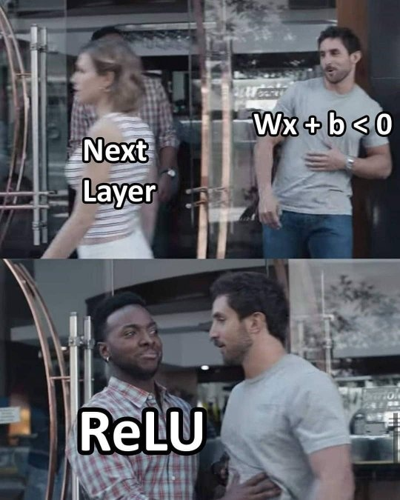
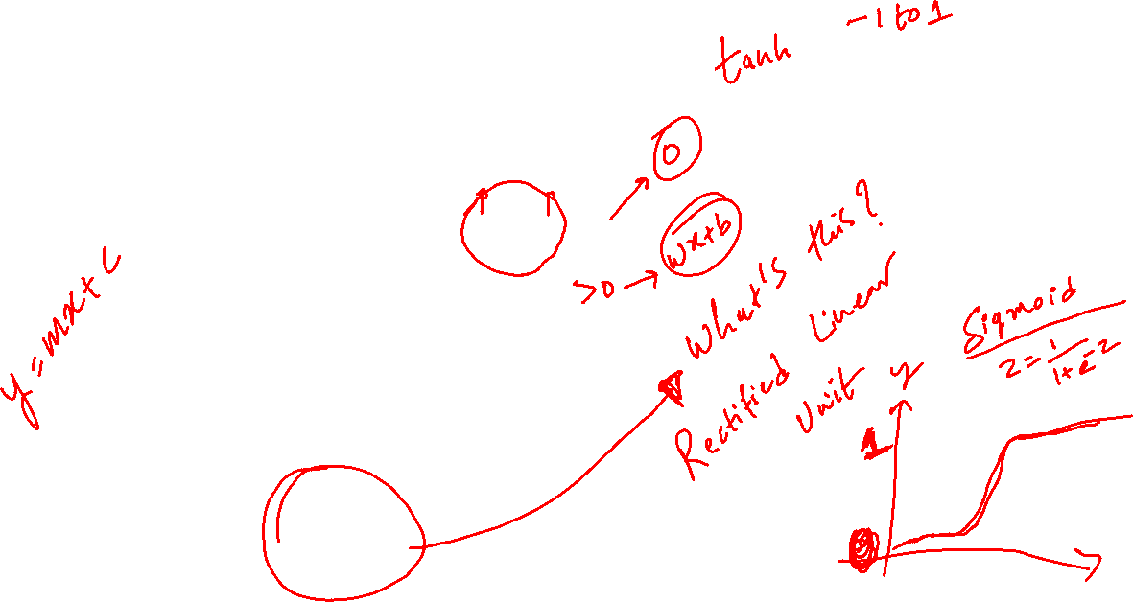
Terminologies in Architecture

Slide 10
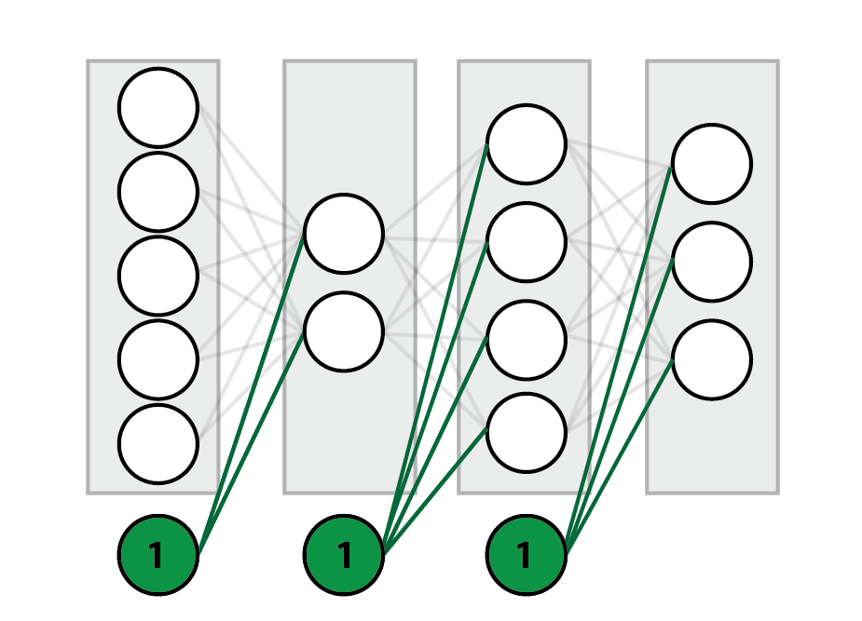
Terminologies in Architecture

Slide 11
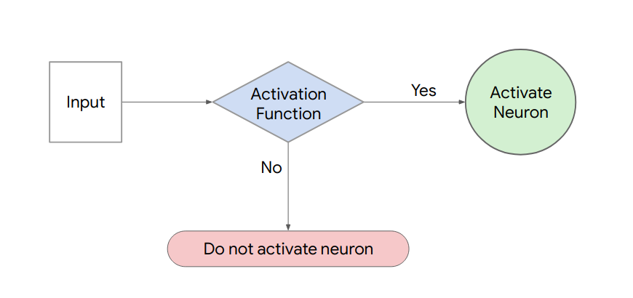

Terminologies in Architecture

Slide 12
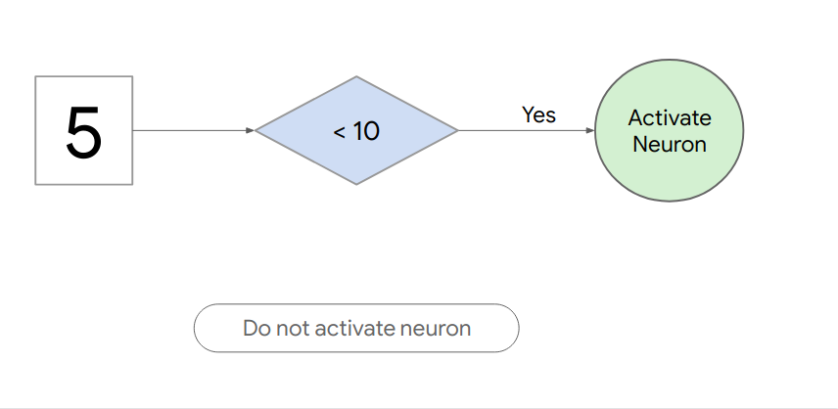

Terminologies in Architecture

Slide 13
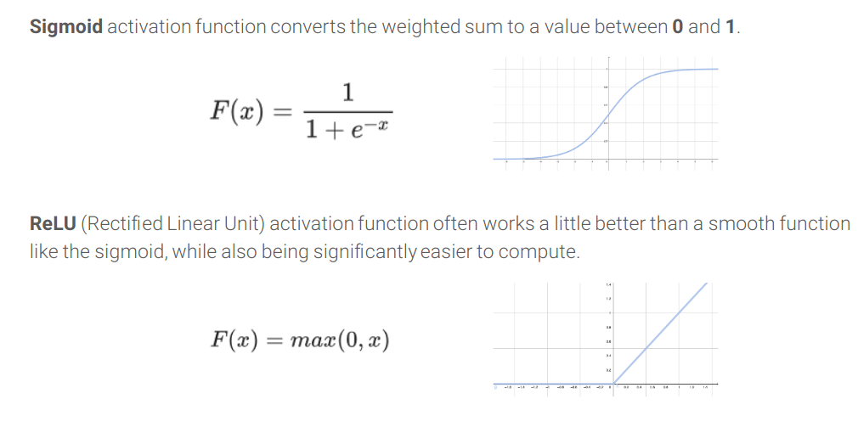
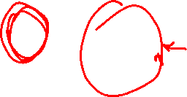
Terminologies in Architecture

Slide 14
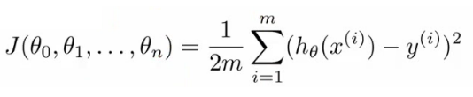
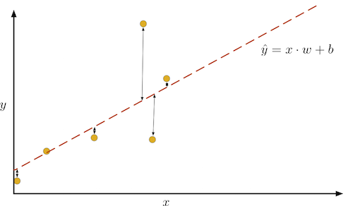
The Loss Function
To determine how well a model is doing, we measure the distance between the model's prediction (indicated in the graph by the dotted red line) and the example data (yellow dots). This is known as loss.
The Machine Learning & Deep Learning Show: Lecture 01

Slide 15
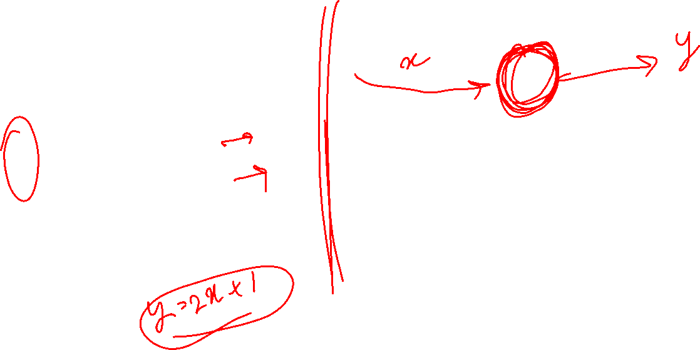
Working
Aim: Pattern Recognition
X= [ 0 , 3 , 5 , 6 , 8 ]
Y=[ 1 , 7 , 11 , 13 , 17 ]
Can you see the pattern?

Slide 16

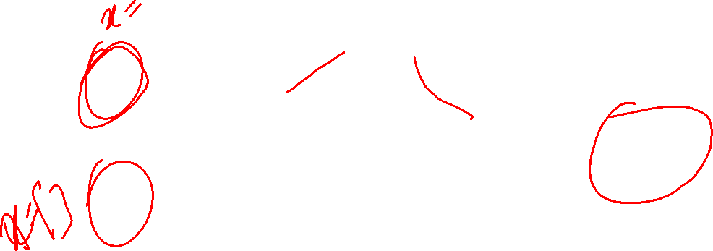
Neural Networks
Source: Analytics Vidhya website
Understanding ML through Memes

Slide 17
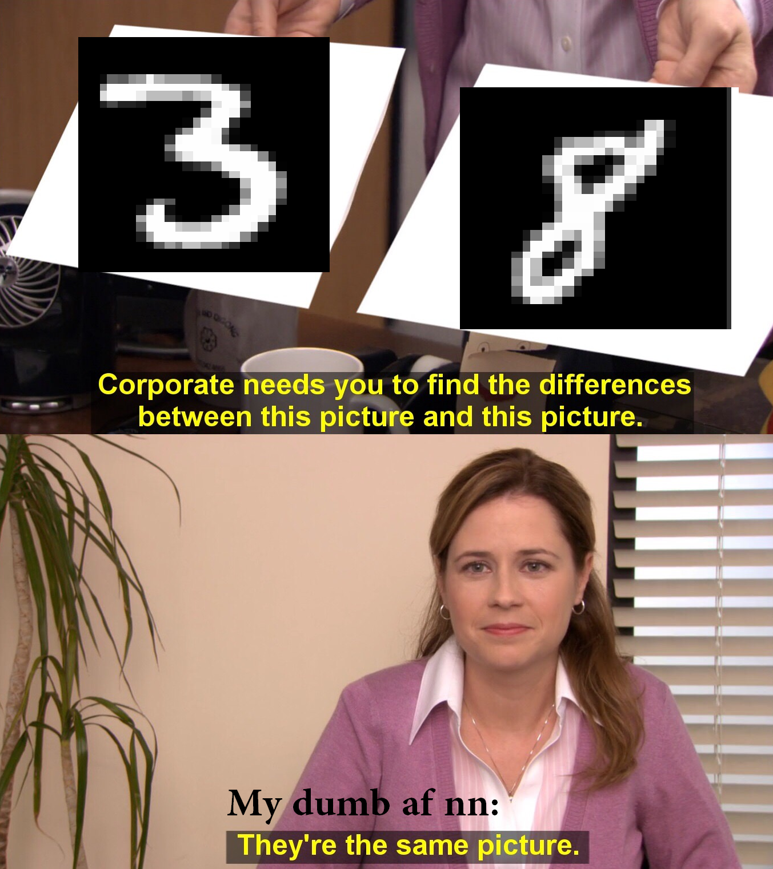
Neural Networks
Via: Reddit
Understanding ML through Memes

Slide 18
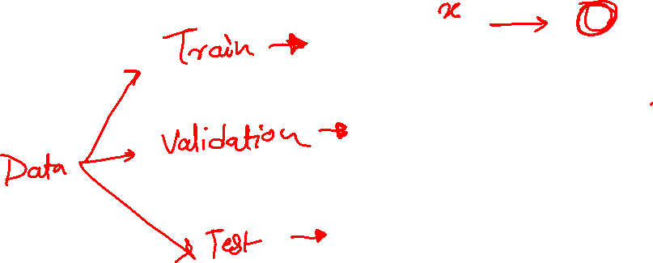

Slide 19
Code

Slide 20
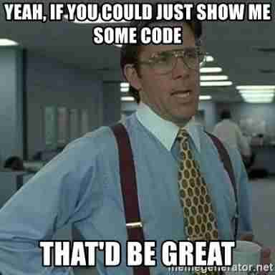
Ready for Code?
Understanding ML through Memes

Slide 21
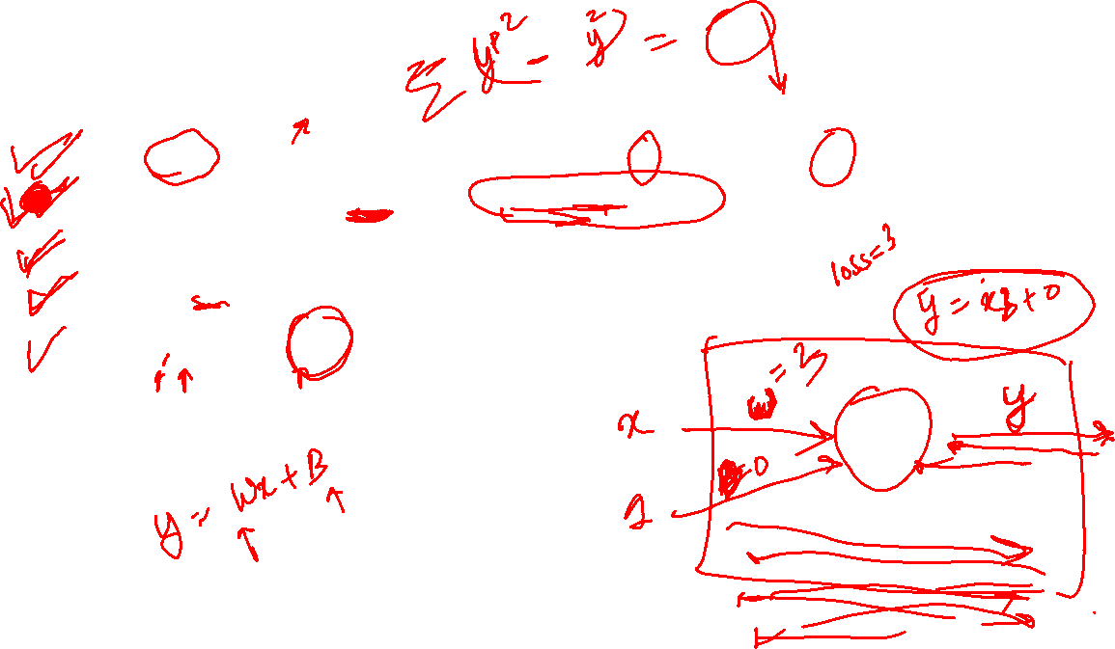
Let’s Code
model = keras.Sequential([keras.layers.Dense(units=1, input_shape=[1])])
model.compile(optimizer=‘sgd’, loss=‘mean_squared_error’)
x= np.array([0.0 ,3.0 ,5.0 ,6.0 ,8.0], dtype=float)
y= np.array([1.0 ,7.0, 11.0 ,13.0 ,17.0], dtype=float)
model.fit(x,y, epochs=500)

Slide 22
Forward & Back Propagation

Slide 23

Forward & Backward Prop

Slide 24
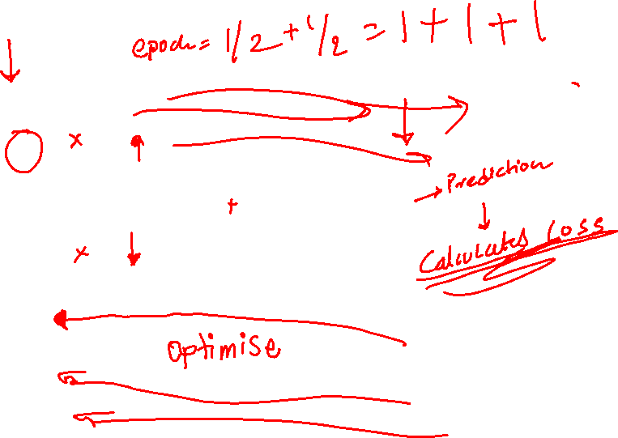
Forward & Backward Propagation
X
W
∑
y
y
1
B

Slide 25
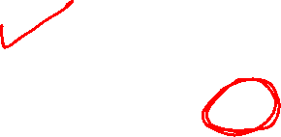
Forward & Backward Propagation
When training a network, we repeat the following steps (for n epoches):
Perform forward pass.
Calculate ∆W (the delta to be added to each weight) via backpropagation.
Update the weights.

Slide 26
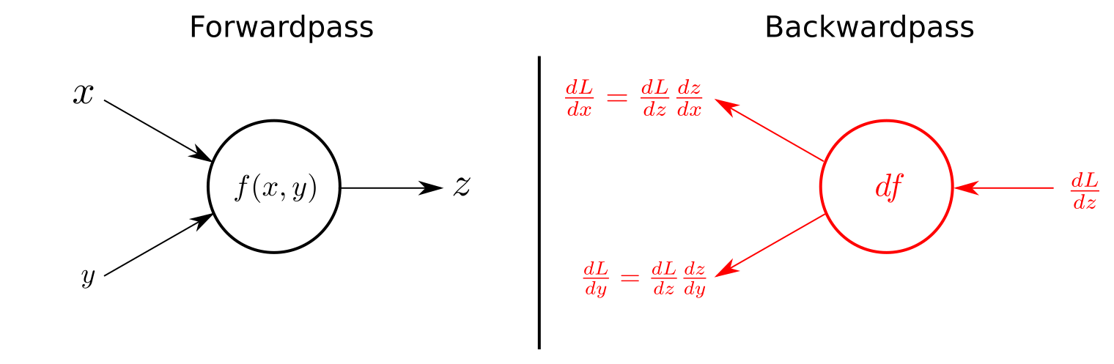
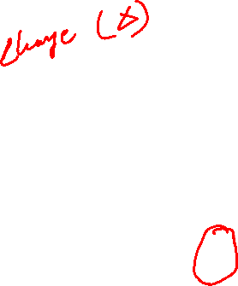
Forward & Backward Propagation

Slide 27
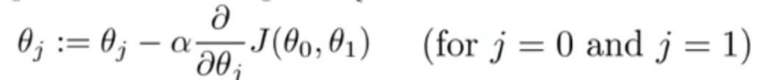
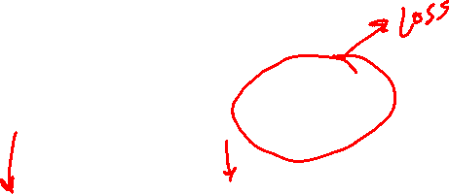
Forward & Backward Propagation

Slide 28
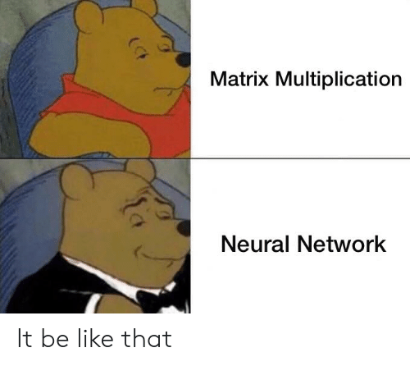
Neural Networks
Understanding ML through Memes

Slide 29
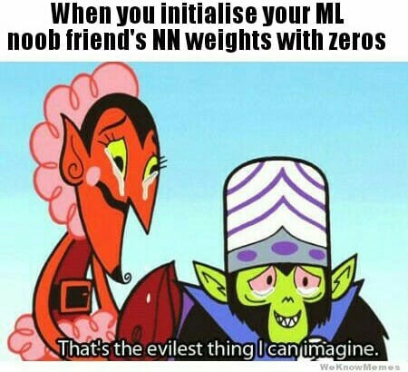
Neural Networks
Understanding ML through Memes

